Slide 1
Phase One Hearing - Utility Presentation
Presentation to Board of Commissioners of Public Utilities
March 30, 2015

Slide 2
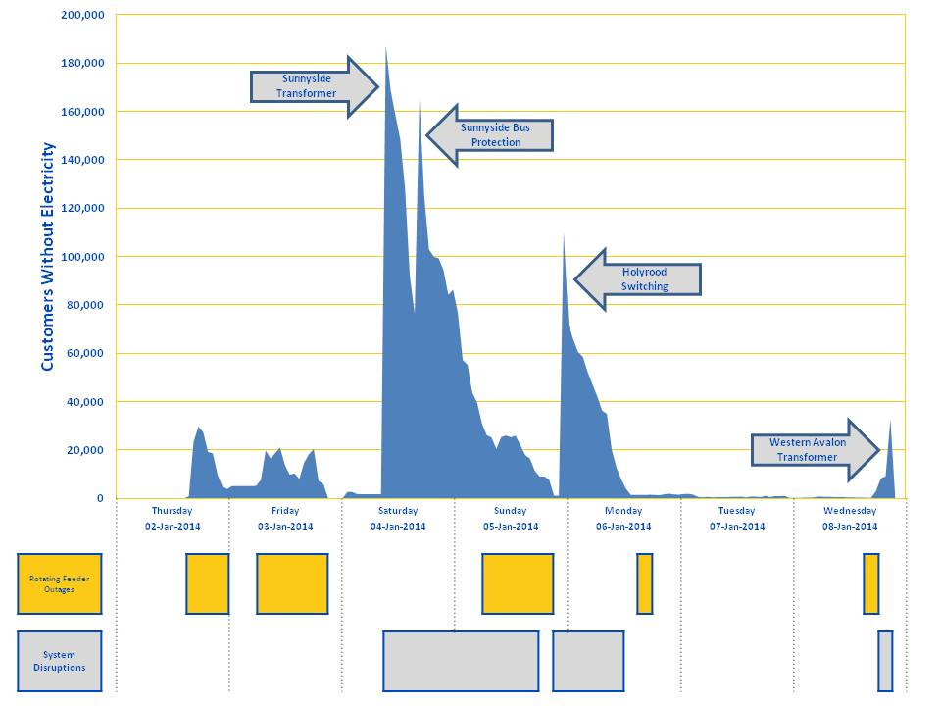
What Happened

Slide 3
Customer Communications
Strengthened website reliability
Increased telephone capacity
Introduced text/email alerts

Slide 4
The Electrical System
Added further grid automation
Improved breaker inspection
Improved generation availability

Slide 5
Inter-Utility Coordination
Improved system data availability
Revised treatment of system reserves
Introduced customer notification protocol

Slide 6
Rotating Outages
[details of rotating outages in January 2014, Newfoundland Power’s rotating outages operating protocol, and current capabilities].
Date | Time | Feeder Rotations | Average Duration (minutes)
Thursday January 2, 2014 | 4:13 pm to 10:45 pm | 77 | 88
Friday January 3, 2014 | 6:57 am to 7:36 pm | 141 | 44
Sunday January 5, 2014 | 7:23 am to 8:29 pm | 158 | 54
Monday January 6, 2014 | 5:17 pm to 10:48 pm | 39 | 47
Wednesday January 8, 2014 | 3:23 pm to 5:42 pm | 32 | 25

Slide 7
Critical Customers
Health, safety and welfare
Responsive to emergency circumstances
Consistent with utility practice

Slide 8
Preparedness
Continuing supply risk
Preparedness improved
Further improvement

Slide 9
Phase One Hearing - Utility Presentation
Presentation to Board of Commissioners of Public Utilities
March 30, 2015

